Slide 1


Pet products web application
PRODUCT CORNER

Slide 2
CONTENT
Introduction
Home Page
About us
Latest Products
Contact Page
Login Page

Slide 3
PRODUCT CORNER
Web Application name: PRODUCT CORNER
Logo:
Key features of PRODUCT CORNER:
User-friendly interface ,simple to use.
Easy to navigate (Navigation bar).
Front – End user interface: HTML, CSS.

Slide 4
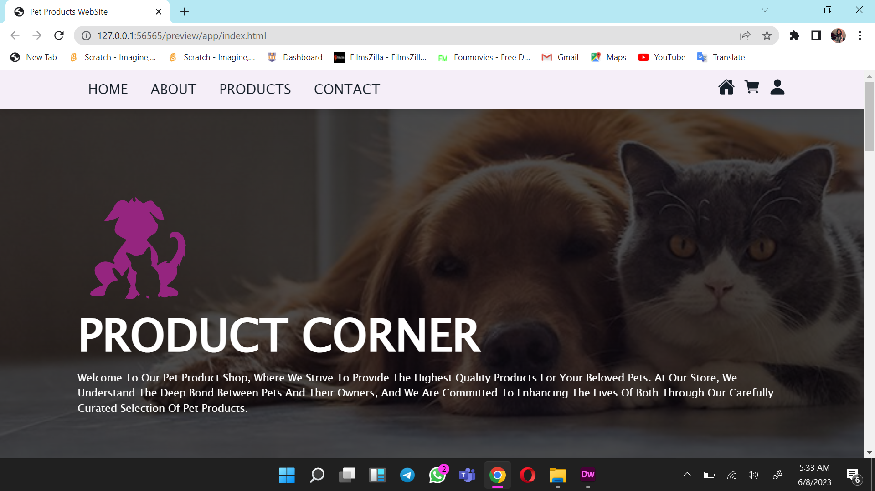
Home Page

Slide 5
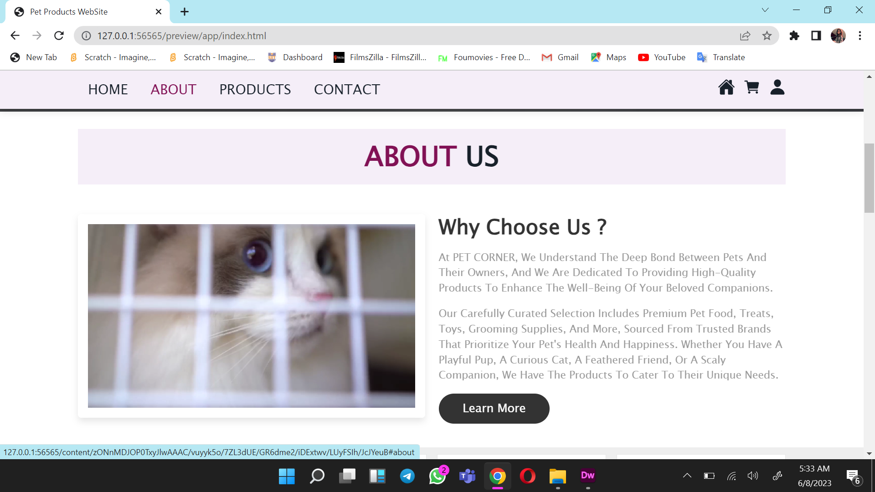
About us Page

Slide 6
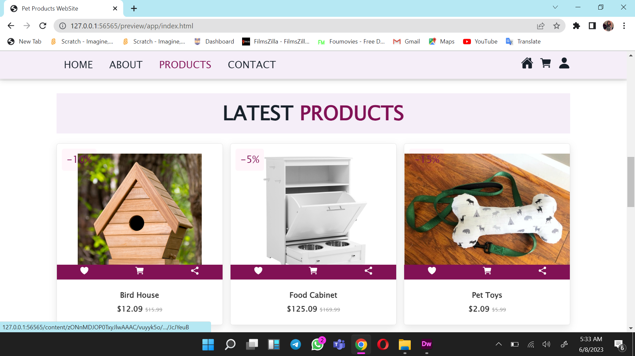
Latest Products

Slide 7
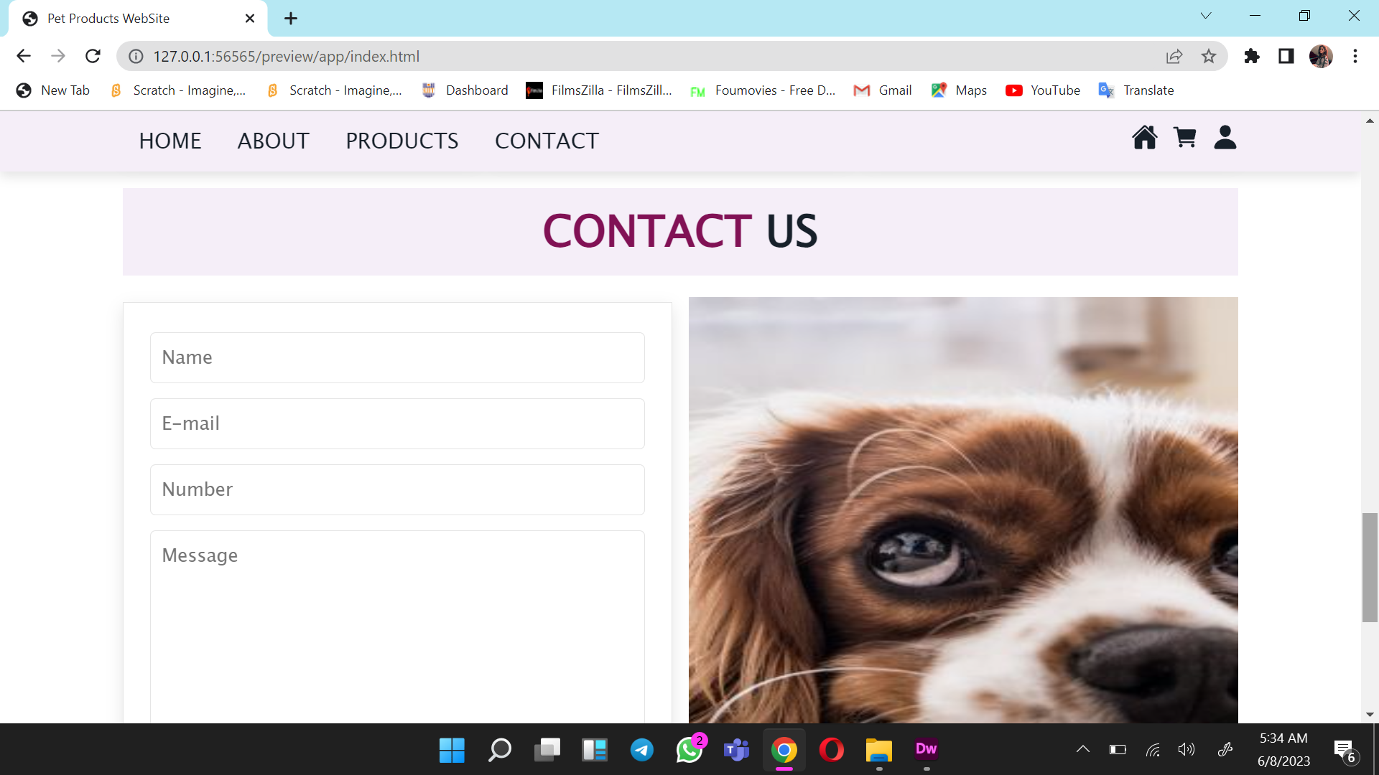
Contact Details

Slide 8
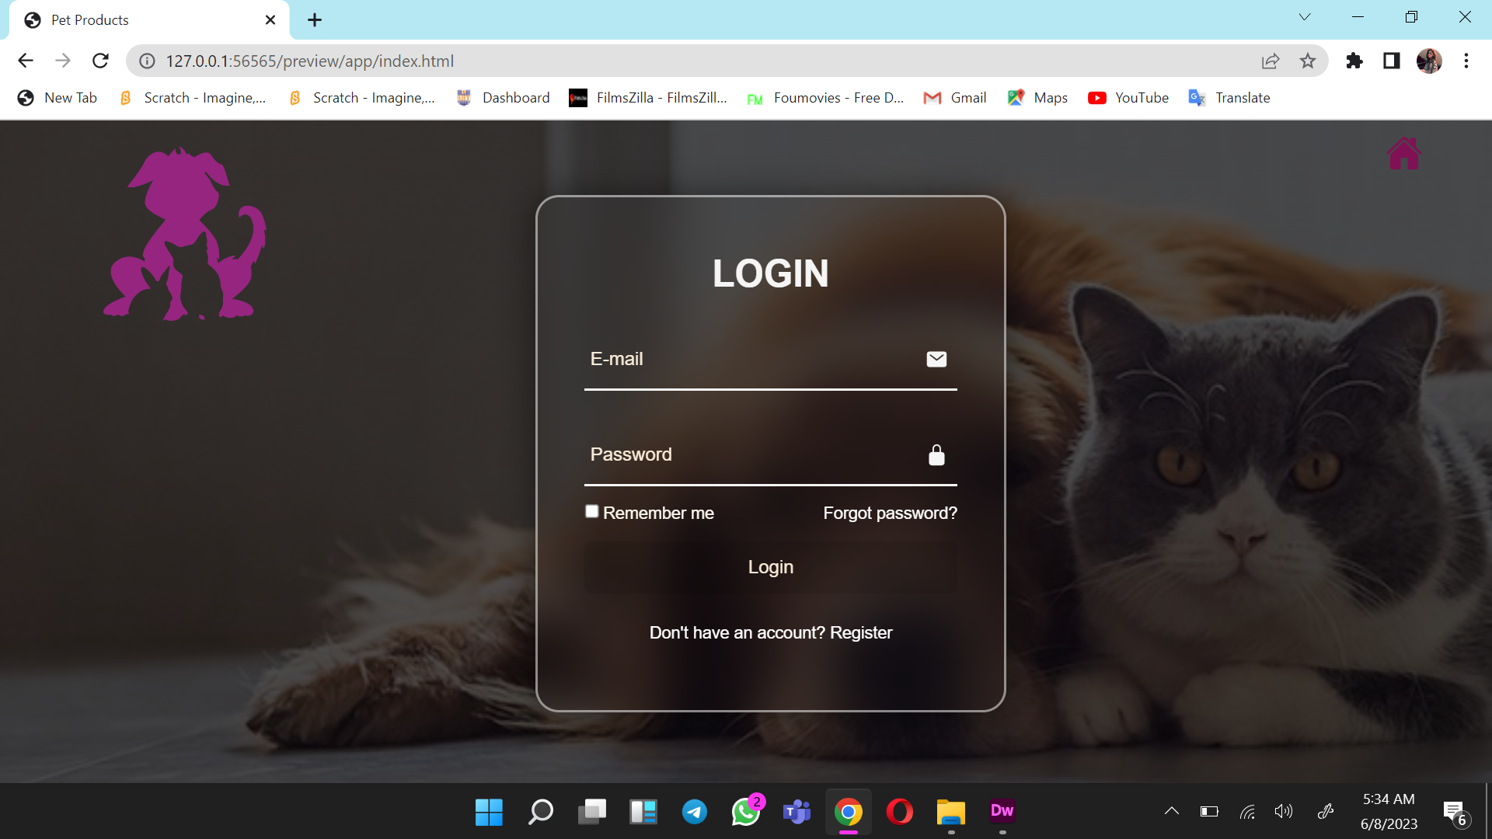
Login Page

Slide 9


